Slide 1
What We Did So Far
December 2018

Slide 2
Monitoring Schemes

Slide 3
Table of Contents
Vector Scheme
Value Scheme
Distance Scheme
Sketched Data Resolution
Sketched Change Resolution

Slide 4
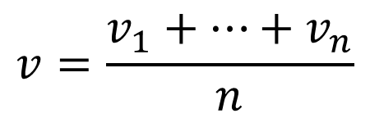

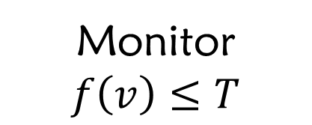
Reminder: Monitoring Objective
$$node_{i}←v_{i}$$
Convex f
$$v=\frac{v_{1}+…+v_{n}}{n}$$
Monitor
$$f\left(v\right)≤T$$

Slide 5
Vector Scheme

Slide 6
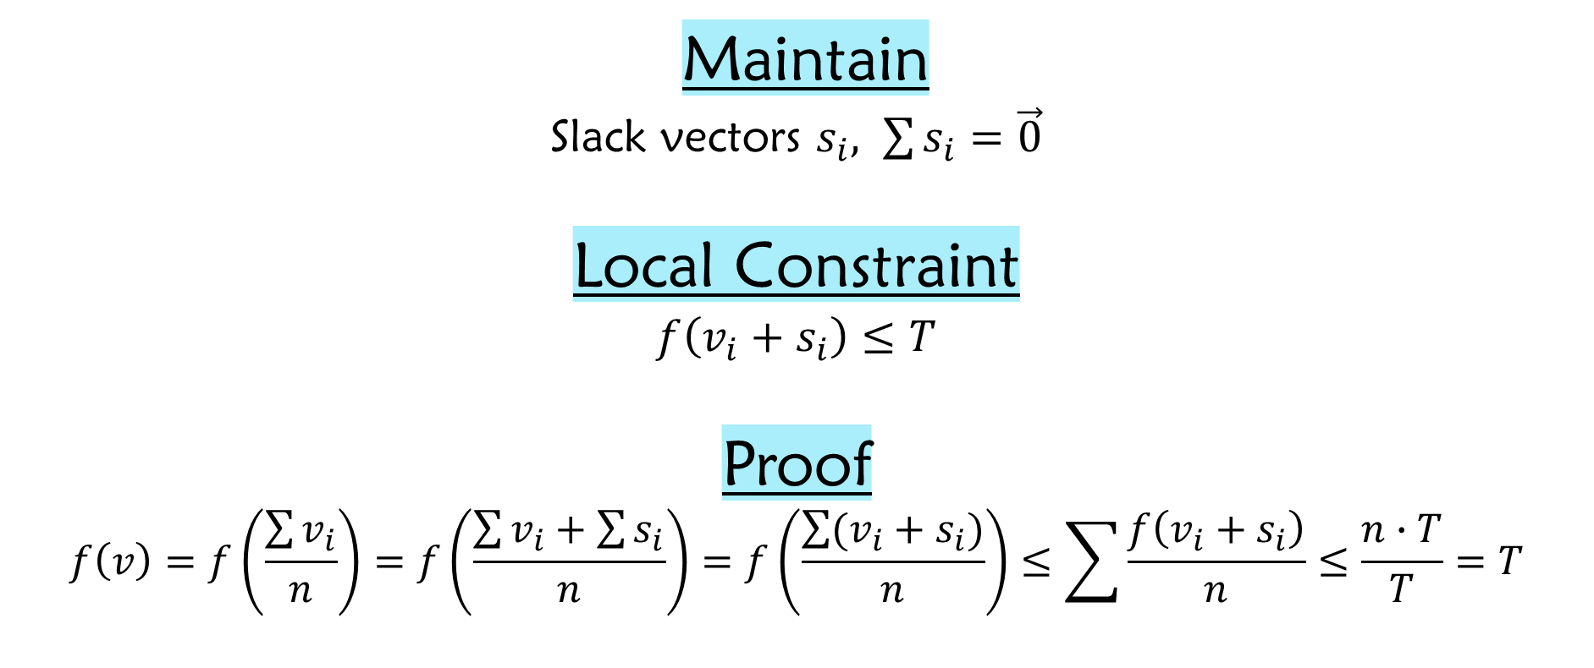
Vector Scheme
Maintain
Slack vectors $s_{i}, \sum{s_{i}}=\vec{0}$
Local Constraint
$$f\left(v_{i}+s_{i}\right)≤T$$
Proof
$$f\left(v\right)=f\left(\frac{\sum{v_{i}}}{n}\right)=f\left(\frac{\sum{v_{i}}+\sum{s_{i}}}{n}\right)=f\left(\frac{\sum{(v_{i}+s_{i})}}{n}\right)≤\sum{\frac{f\left(v_{i}+s_{i}\right)}{n}}≤\frac{n∙T}{T}=T$$

Slide 7
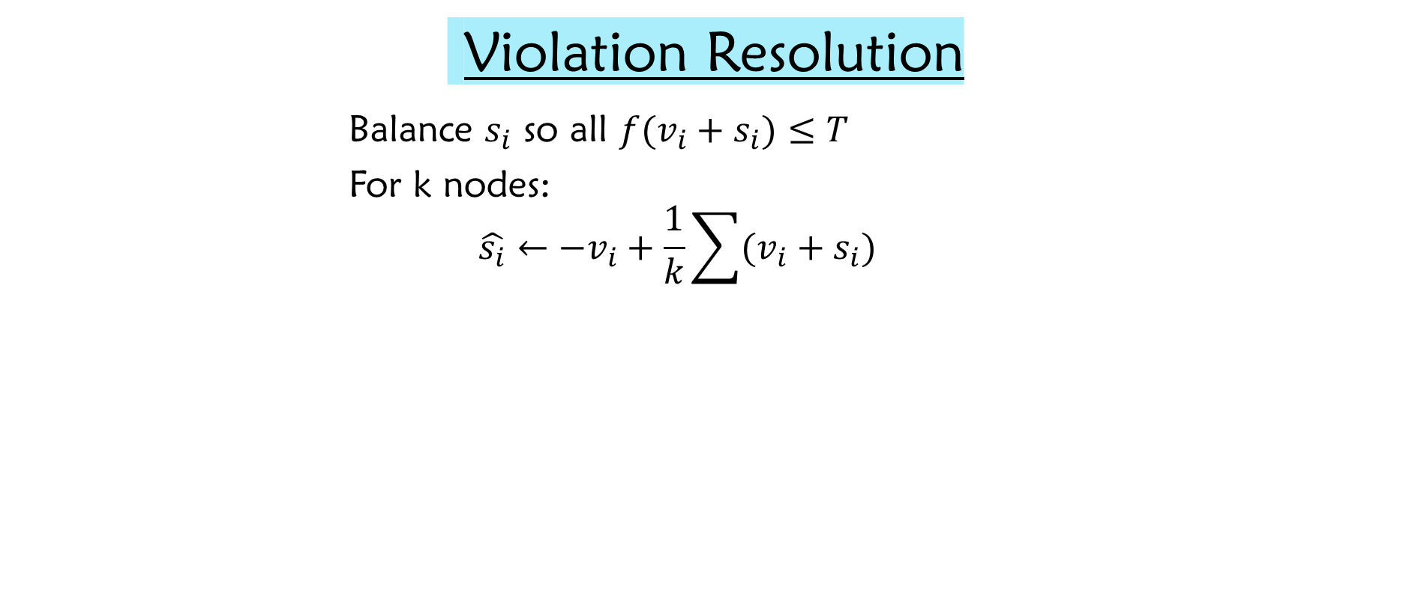
Vector Scheme
Violation Resolution
Balance $s_{i}$ so all $f(v_{i}+s_{i})≤T$
For k nodes:
$$\hat{s_{i}}←−v_{i}+\frac{1}{k}\sum{(v_{i}+s_{i})}$$

Slide 8
Value Scheme

Slide 9
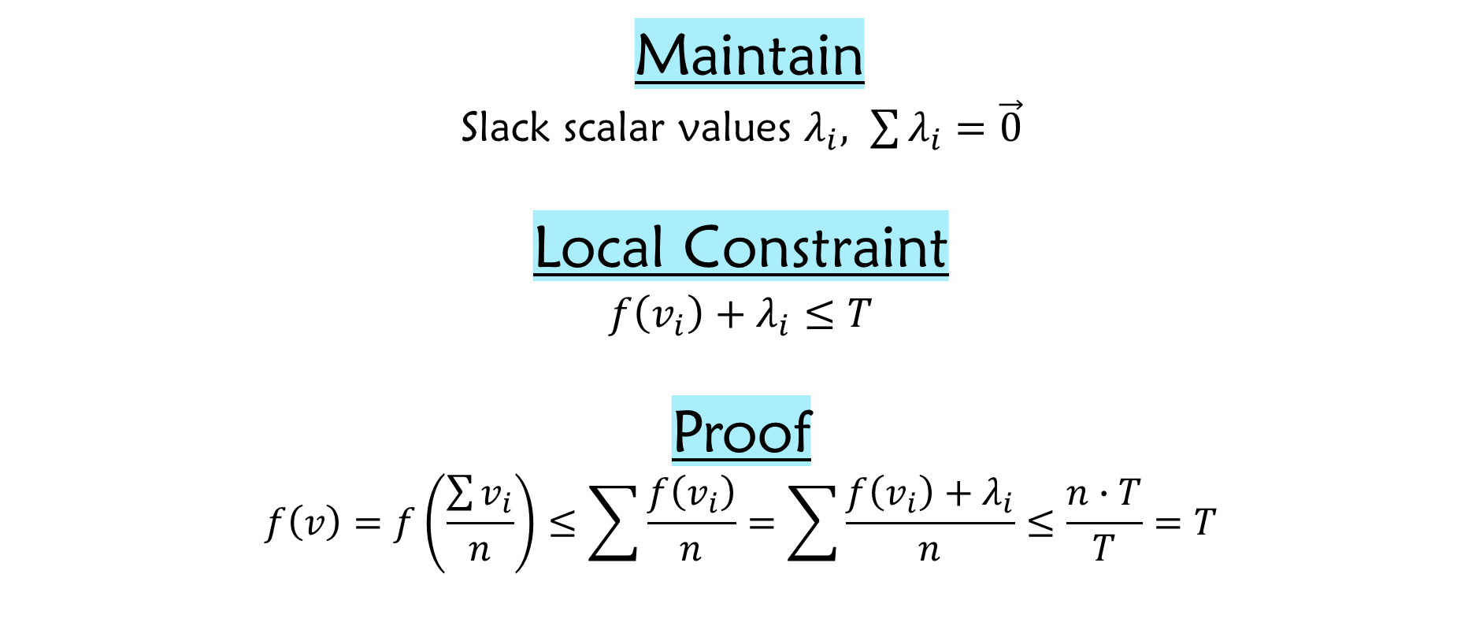
Value Scheme
Maintain
Slack scalar values $λ_{i}, \sum{λ_{i}}=\vec{0}$
Local Constraint
$$f\left(v_{i}\right)+λ_{i}≤T$$
Proof
$$f\left(v\right)=f\left(\frac{\sum{v_{i}}}{n}\right)≤\sum{\frac{f\left(v_{i}\right)}{n}}=\sum{\frac{f\left(v_{i}\right)+λ_{i}}{n}}≤\frac{n∙T}{T}=T$$

Slide 10

Value Scheme
Violation Resolution
Balance $λ_{i}$ so all $f\left(v_{i}\right)+λ_{i}≤T$
For k nodes:
$$\hat{λ_{i}}←−f\left(v_{i}\right)+\frac{1}{k}\sum{(f\left(v_{i}\right)+λ_{i})}$$

Slide 11
Distance Scheme

Slide 12
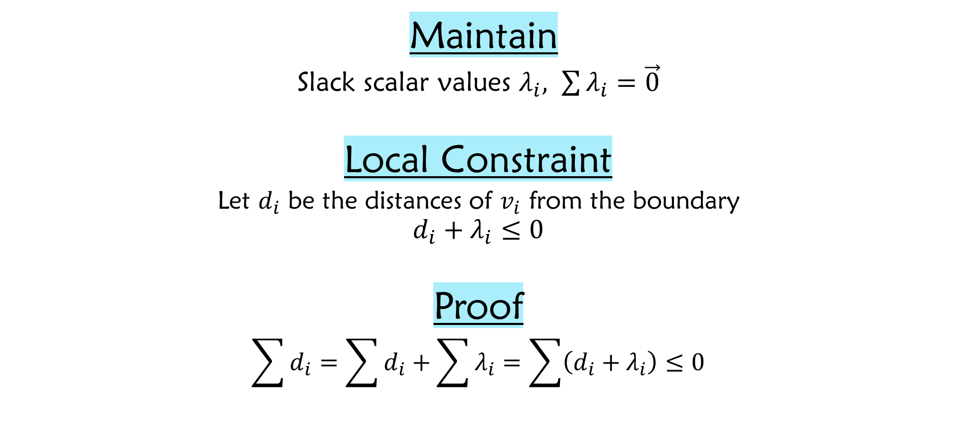
Distance Scheme
Maintain
Slack scalar values $λ_{i}, \sum{λ_{i}}=\vec{0}$
Local Constraint
$$\text{Let} d_{i} \text{be} \text{the} \text{distances} \text{of} v_{i} \text{from} \text{the} \text{boundary}$$
$$d_{i}+λ_{i}≤0$$
Proof
$$\sum{d_{i}}=\sum{d_{i}}+\sum{λ_{i}}=\sum{\left(d_{i}+λ_{i}\right)≤0}$$
Distance Lemma

Slide 13

Distance Scheme
Violation Resolution
Balance $λ_{i}$ so all $d_{i}+λ_{i}≤0$
For k nodes:
$$\hat{λ_{i}}←−d_{i}+\frac{1}{k}\sum{(d_{i}+λ_{i})}$$

Slide 14
Sketched Data Resolution

Slide 15





Gradual Full Sync
Value Scheme
Fail
Success
$||$Sketch$||$ = 2
Fail
Success
$||$Sketch$||$ = 4
$$⋮$$
$$⋮$$
$||$Sketch$||$ = ^{n}/₂

Slide 16
Gradual Full Sync
Distance Scheme
Fail
Success
$||$Sketch$||$ = 2
Fail
Success
$||$Sketch$||$ = 4
$$⋮$$
$$⋮$$
$||$Sketch$||$ = ^{n}/₂

Slide 17
Some Intuition
Vector Scheme’s Resolution
‘Sketched’ Resolution

Slide 18
Some Intuition
Vector Scheme’s Resolution
‘Sketched’ Resolution

Slide 19
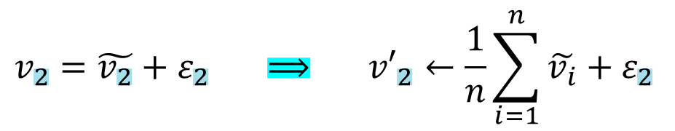

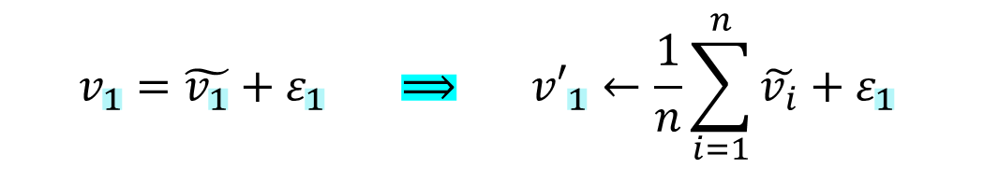





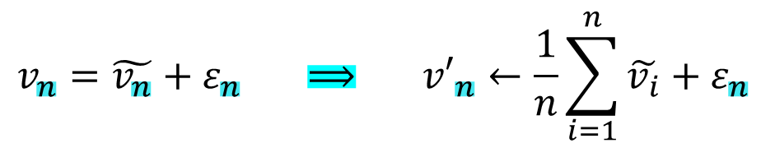
Sketched Data Resolution
Violation Resolution
$$v_{1}=\tilde{v_{1}}+ε_{1} ⟹ {v′}_{1}←\frac{1}{n}\sum_{i=1}^{n}{\tilde{v_{i}}}+ε_{1}$$
$$v_{2}=\tilde{v_{2}}+ε_{2} ⟹ {v′}_{2}←\frac{1}{n}\sum_{i=1}^{n}{\tilde{v_{i}}}+ε_{2}$$
Coordinator
$$\frac{1}{n}\sum_{i=1}^{n}{\tilde{v_{i}}}$$
$$\frac{1}{n}\sum_{i=1}^{n}{\tilde{v_{i}}}$$
$$⋮$$
$$v_{n}=\tilde{v_{n}}+ε_{n} ⟹ {v′}_{n}←\frac{1}{n}\sum_{i=1}^{n}{\tilde{v_{i}}}+ε_{n}$$
$$\tilde{v_{1}}$$
$$\tilde{v_{2}}$$
$$\tilde{v_{n}}$$
…

Slide 20
Sketched Change Resolution

Slide 21






Sketched Change Resolution
Violation Resolution
Recall, $v_{i}=ref+chng$
Perform sketch function on $chng$ instead
of on $v_{i}$
Coordinator
$$\frac{1}{n}\sum_{i=1}^{n}{\tilde{{chng}_{i}}}$$
$$\frac{1}{n}\sum_{i=1}^{n}{\tilde{{chng}_{i}}}$$
$$\tilde{{chng}_{1}}$$
$$\tilde{{chng}_{2}}$$
$$\tilde{{chng}_{n}}$$
…

Slide 22
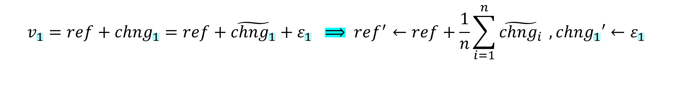

Sketched Change Resolution
Violation Resolution
$$v_{1}=ref+{chng}_{1}=ref+\tilde{{chng}_{1}}+ε_{1} ⟹ ref^{′}←ref+\frac{1}{n}\sum_{i=1}^{n}{\tilde{{chng}_{i}}} ,{chng}_{1}′←ε_{1}$$
$$v_{2}=ref+{chng}_{2}=ref+\tilde{{chng}_{2}}+ε_{2} ⟹ ref^{′}←ref+\frac{1}{n}\sum_{i=1}^{n}{\tilde{{chng}_{i}}} ,{chng}_{2}′←ε_{2}$$
$$⋮$$
$$v_{n}=ref+{chng}_{n}=ref+\tilde{{chng}_{n}}+ε_{n} ⟹ ref^{′}←ref+\frac{1}{n}\sum_{i=1}^{n}{\tilde{{chng}_{i}}} ,{chng}_{n}′←ε_{n}$$

Slide 23
Monitored Functions

Slide 24
Table of Contents
Inner Product
Entropy
Norm Squared
Spectral Gap
AMS F₂

Slide 25
Inner Product

Slide 26
Inner Product
f(x,y)=<x,y>
 | Bounding Convex Function | Distance to Convex Function
Upper Bound | Mathematical Solution | Mathematical Solution
Lower Bound | Mathematical Solution | Mathematical Solution

Slide 27
Entropy

Slide 28
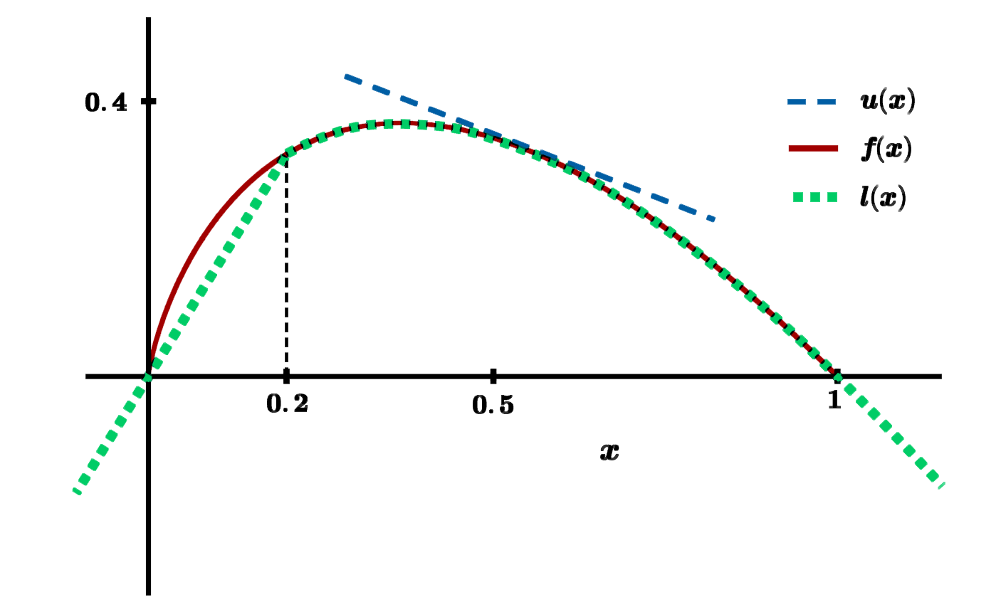
Entropy
f(x)=-$Σ$(x_{i}$∙$ln(x_{i}))

Slide 29
Entropy
f(x)=-$Σ$(x_{i}$∙$ln(x_{i}))
 | Bounding Convex Function | Distance to Convex Function
Upper Bound | Tangent Plane | Mathematical Solution
Lower Bound | Function Itself | Computational Method

Slide 30
Norm Squarred

Slide 31
Norm Squared
f(x)= $||$x$||$²
 | Bounding Convex Function | Distance to Convex Function
Upper Bound | Tangent Plane | Mathematical Solution
Lower Bound | Function Itself | Mathematical Solution

Slide 32
Spectral Gap

Slide 33
Spectral Gap
f(M)= $λ$₁(M)-$λ$₂(M)
 | Bounding Convex Function | Distance to Convex Function
Upper Bound | ??? | ???
Lower Bound | Mathematical Solution | Bound of Distance

Slide 34
AMS F₂

Slide 35
AMS F₂
f(M)= median of row averages of M$∙$M (pointwise mul)
 | Bounding Convex Function | Distance to Convex Function
Upper Bound | Mathematical Solution | Mathematical Solution
Lower Bound | ??? | ???

Slide 36
Experimental Results

Slide 37
Bag-of-Words Textual Data Sources
Spam click-baits new headlines
News pieces from India
Reddit comments from 2015
Tweets from the end of 2009
Restaurant Reviews
Blogs textual data
Wikipedia article as of March 2017
Amazon reviews of movies

